Slide 1
R-studio Projects & assignments
Submitted By: Akash Pratap Singh
(PG Diploma Data Science)

Slide 2
Assignment 1

Slide 3
Data Manipulation
Manipulation of data is the process of manipulating or changing information to make it more organized and readable.
With the help of data structures, we can represent data in the form of data analytics. Data Manipulation in R can be carried out for further analysis and visualisation.
One of the most important aspects of computing with Data Manipulation in R is that it enables its subsequent analysis and visualization.

Slide 4
Iris Dataset
The Iris Dataset contains four features (length and width of sepals and petals) of 50 samples of three species of Iris (Iris setosa, Iris virginica and Iris versicolor). These measures were used to create a linear discriminant model to classify the species.
The dataset is often used in data mining, classification and clustering examples and to test algorithms.

Slide 5
dplyr
dplyr is a new package which provides a set of tools for efficiently manipulating datasets in R. dplyr is the next iteration of plyr, focusing on only data frames. dplyr is faster, has a more consistent API and should be easier to use.

Slide 6
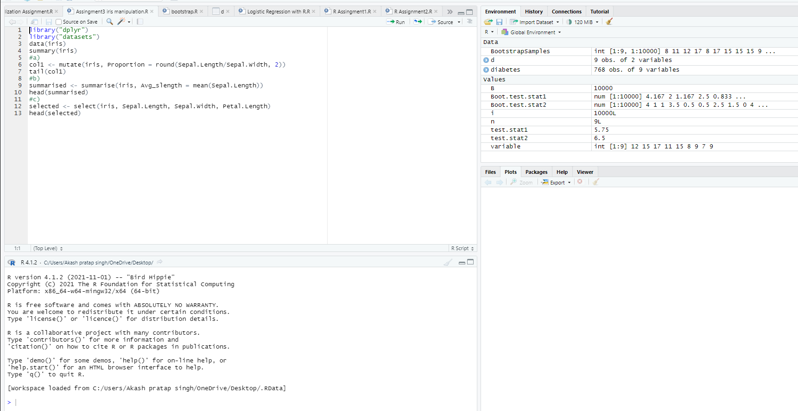
Data Manupulation Working

Slide 7
Assignment 2

Slide 8
DataVisualization
Data visualization is the technique used to deliver insights in data using visual cues such as graphs, charts, maps, and many others. This is useful as it helps in intuitive and easy understanding of the large quantities of data and thereby make better decisions regarding it.

Slide 9
ggplot2
ggplot2 is a system for declaratively creating graphics, based on The Grammar of Graphics. You provide the data, tell ggplot2 how to map variables to aesthetics, what graphical primitives to use, and it takes care of the details.
It’s hard to succinctly describe how ggplot2 works because it embodies a deep philosophy of visualisation. However, in most cases you start with ggplot(), supply a dataset and aesthetic mapping (with aes()). You then add on layers (like geom_point() or geom_histogram()), scales (like scale_colour_brewer()), faceting specifications (like facet_wrap()) and coordinate systems (like coord_flip()).

Slide 10
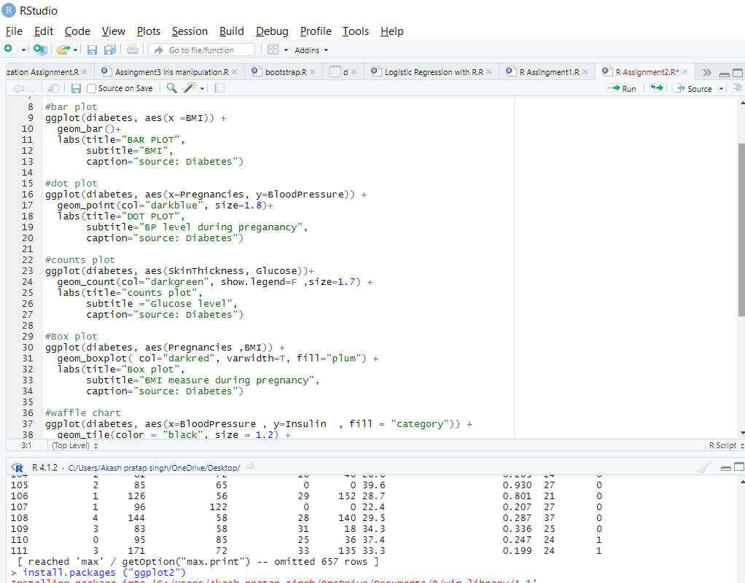
Bar Plot/Dot plot/ Counts plot

Slide 11
Assignment 3

Slide 12
Map Visualization
Map visualization is used to analyze and display the geographically related data and present it in the form of maps. This kind of data expression is clearer and more intuitive. We can visually see the distribution or proportion of data in each region.

Slide 13
Tidyverse
Tidyverse is a collection of essential R packages for data science. The packages under the tidyverse umbrella help us in performing and interacting with the data. There are a whole host of things you can do with your data, such as subsetting, transforming, visualizing, etc.

Slide 14
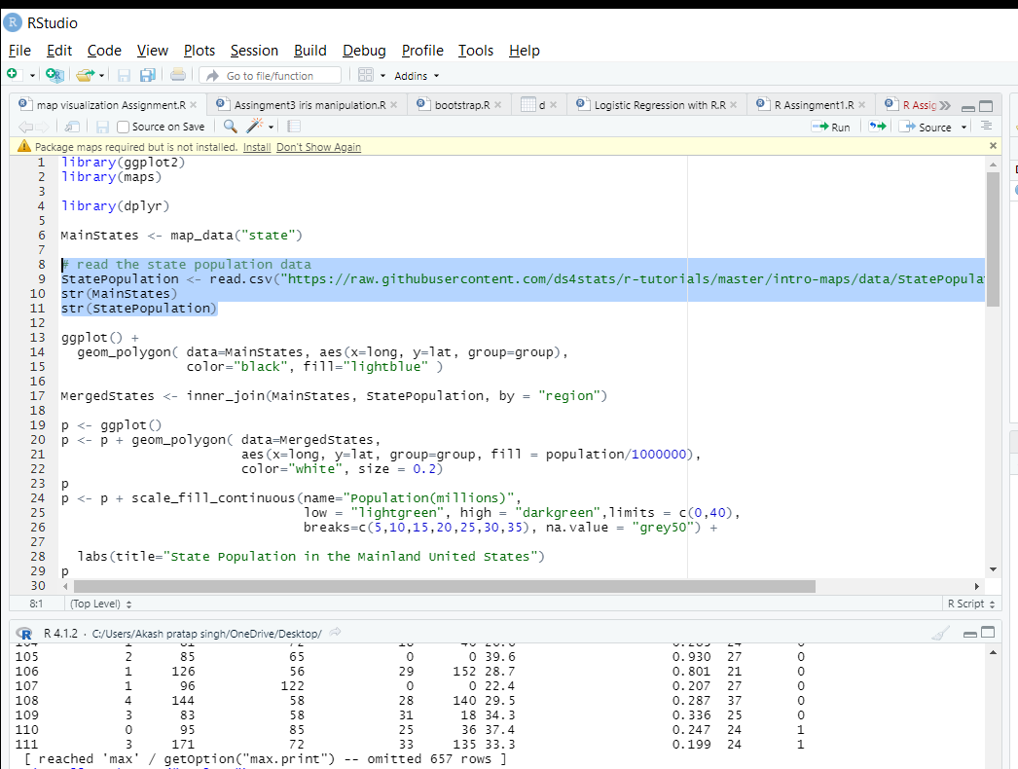
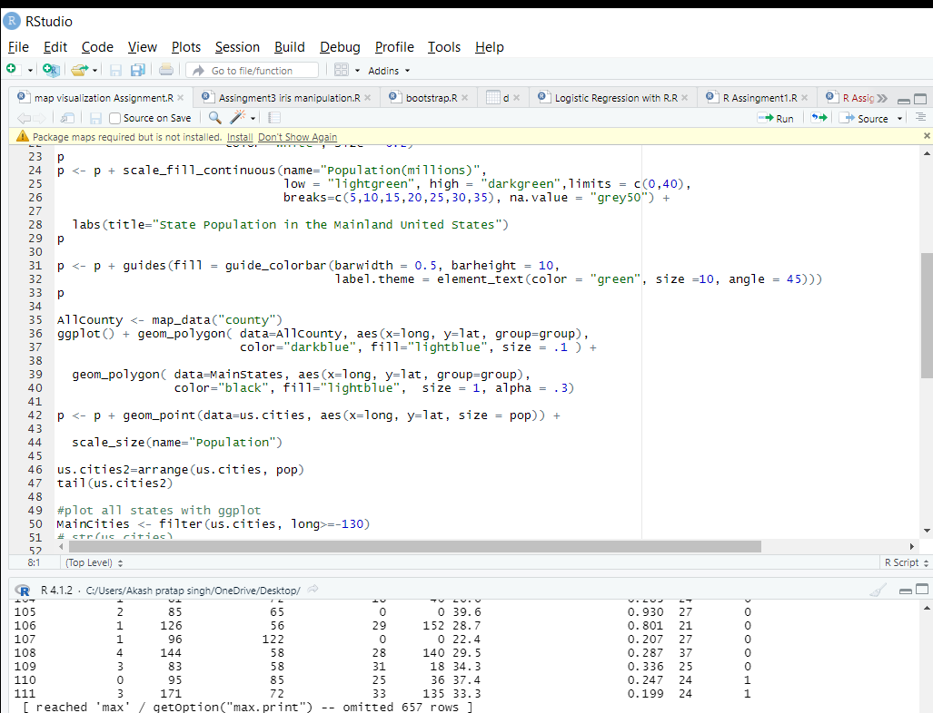
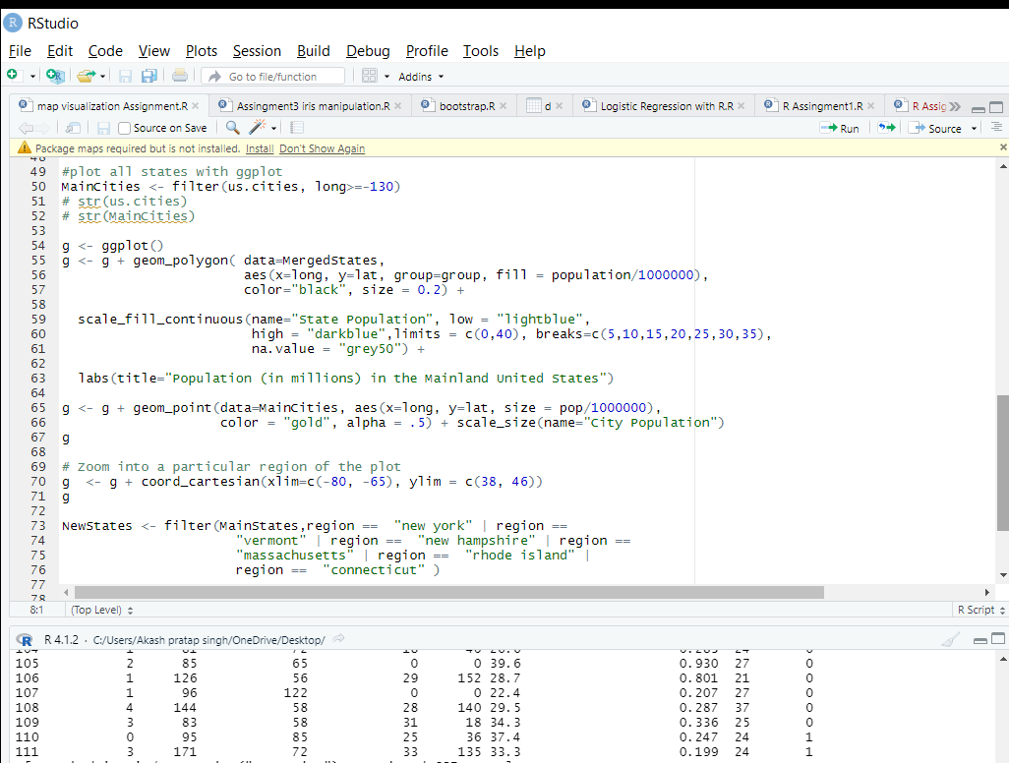
Map Visualization Working

Slide 15
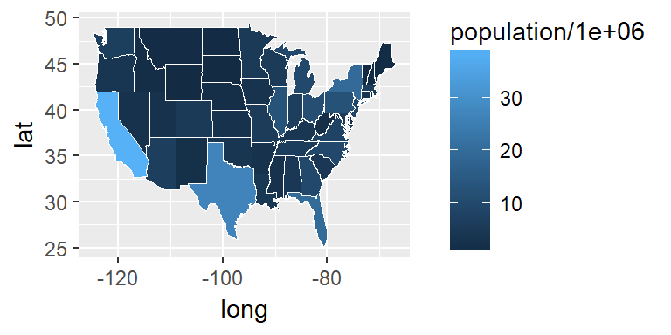
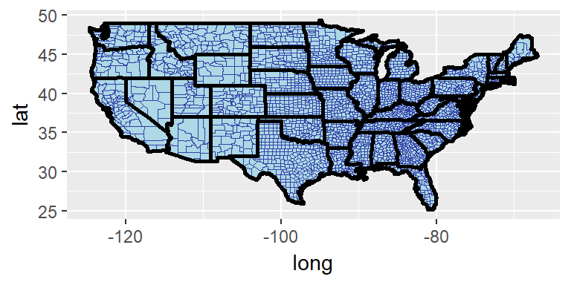
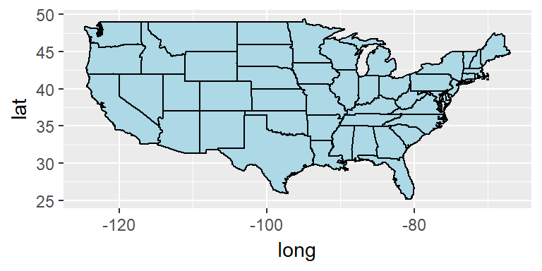
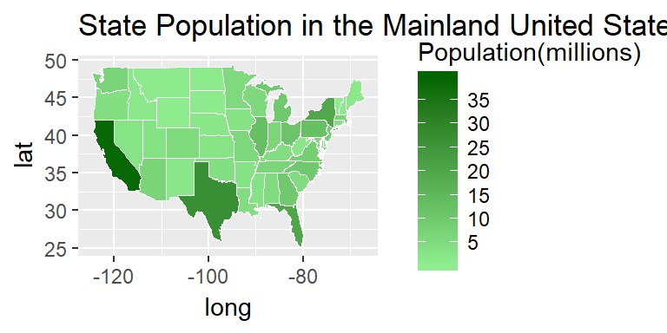
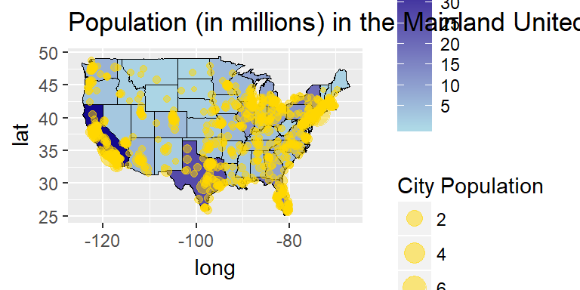
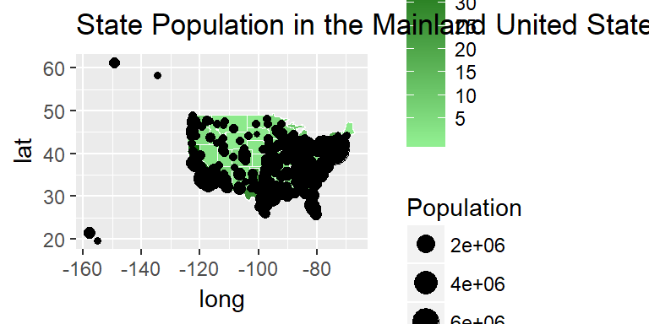
Map Visualization

Slide 16
Assignment 4

Slide 17
Bootstrap
Bootstrapping can be a very useful tool in statistics and it is very easily implemented in R. Bootstrapping comes in handy when there is doubt that the usual distributional assumptions and asymptotic results are valid and accurate. Bootstrapping is a nonparametric method which lets us compute estimated standard errors, confidence intervals and hypothesis testing.

Slide 18
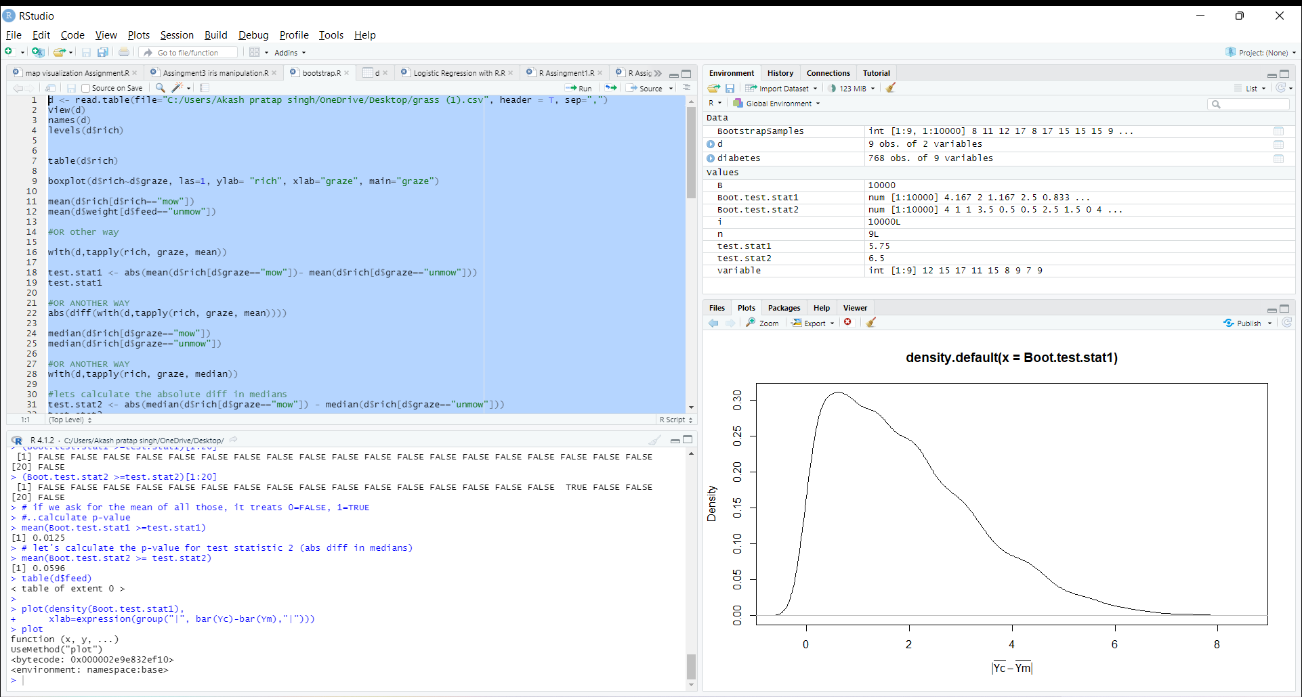
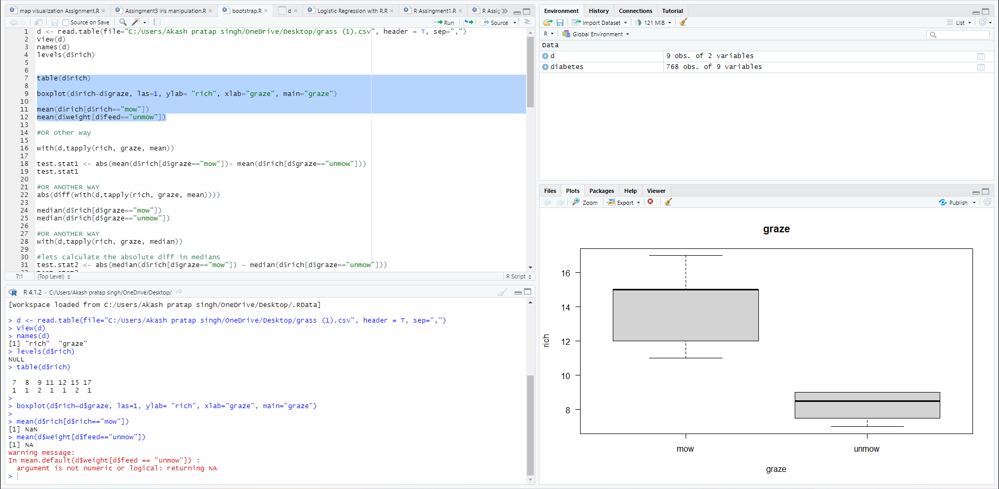
Bootstrap

Slide 19
Thank you

